Slide 1
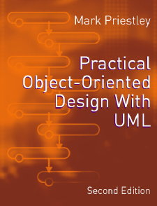
PRACTICAL
OBJECT-ORIENTED
DESIGN WITH UML
2e
Chapter 2:
Modelling with Objects

Slide 2
The Object Model
A general view of program structure shared by UML and object-oriented programming languages like Java and C++
Computation takes place in objects that:
  store data and implement behaviour
  are linked together in a network
  communicate by sending messages
  are described by classes

Slide 3
UML and Code
Because of the shared object model:
  UML diagrams can easily be implemented
  object-oriented programs can easily be documented in UML
Reverse engineering:
  creating a UML model for existing code
  often useful in dealing with undocumented legacy systems

Slide 4
Stock Control Example
Keep track of parts in a warehouse and how they are used
  parts have a part number, name and cost
  the system must track individual parts
  parts can be used to form assemblies
  assemblies have a hierarchical structure
Could be used for a variety of applications
  e.g. find the cost of the materials in an assembly

Slide 5
A Simple Part Class
  public class Part {
    private String name ;
    private long number ;
    private double cost ;
    public Part(String nm, long num, double cost) {
    name = nm ;
    // etc
    }
    public String getName( ) { return name; }
    // etc
  }

Slide 6
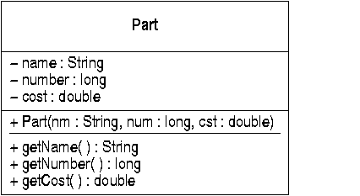
The Part Class in UML
A class is represented by a single UML icon
P
p

Slide 7
UML Class Notation
Class icons have three compartments
  the first shows the class name
  the second optionally shows attributes
    derived from its fields (data members)
  the third optionally shows operations
    derived from its methods (member functions)
    constructors (and static methods) underlined
Class features = attributes + operations
  access levels: public (+) and private (-)

Slide 8
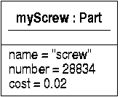
Objects
Objects are created at run-time as instances of classes:
    Part myScrew = new Part(“screw”, 28834, 0.02) ;
Individual objects can be shown in UML:

Slide 9
UML Object Notation
Object icons have two compartments
  the first shows the object and class names
    variable names can be used as object names
    the object name is optional
    the class name is preceded by a colon
    the names are always underlined
  the second shows the actual data stored in the object, as attribute/value pairs
    this compartment is usually omitted

Slide 10
Object Properties
Objects have:
  state: the data values held in the object
  behaviour: the functionality it contains
  identity: a distinguishing property of an object
    not an attribute value
    could be the object's address in memory
  names: useful in modelling to refer to object
Objects normally encapsulate their data

Slide 11
Avoid Data Replication
All parts of the same kind have the same attribute values (name, number, cost)
  wasteful of resources
  hard to maintain, eg if the cost changes
Better to create a new class for shared data
  call this a ‘catalogue entry’
  describes a type of part
  each individual part described by one entry

Slide 12
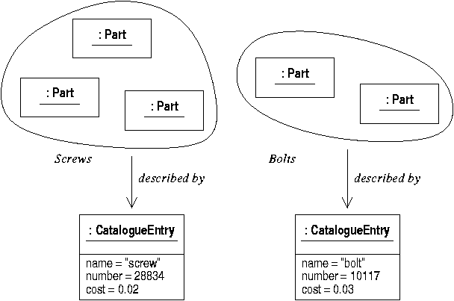
Parts and Catalogue Entries

Slide 13
Implementation
Catalogue entry class defines shared data
Each part holds a reference to an entry
    public class Part {
      private CatalogueEntry entry ;
      public Part(CatalogueEntry e) { entry = e; }
    }
When parts are created, an entry is given
    CatalogueEntry screw = new CatalogueEntry(“screw”,28834,0.02);
    Part s1 = new Part(screw) ;
    Part s2 = new Part(screw) ;

Slide 14
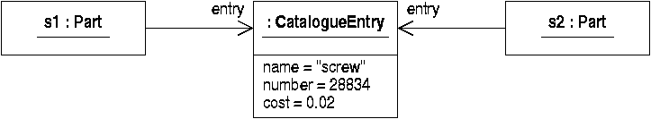
Links
References can be shown in UML as links
  object name is name of variable
  field name ‘entry’ used to label end of link

Slide 15
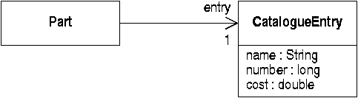
Associations
Data relationships between classes
Links are instances of associations

Slide 16
Properties of Associations
Associations can have:
  a name (not shown)
  a rolename at each end
    derived from field name in code
  a multiplicity at either end
    this specifies how many links there can be
  an arrowhead at either end showing navigability
    derived from direction of reference in code

Slide 17
UML Diagram Types
Object diagrams show objects and links
  this describes the run-time properties of a program
Class diagrams show classes and associations
  this shows the compile-time properties of a program
  i.e. the logical structure of its source code

Slide 18
Object Interaction
Objects interact by method calls
      public class Part {
        private CatalogueEntry entry ;
        public double cost( ) { return entry.getCost(); }
      }
      ...
      Part s1 = new Part(screw) ;
      double s1cost = s1.cost() ;
Functionality is distributed among objects which must communicate

Slide 19

Messages
Object communication is shown in UML as message passing
  a message corresponds to a method call
  the class of the client object is not specified in this diagram

Slide 20
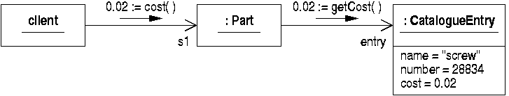
Collaboration Diagrams
Object diagrams with messages show collaborations
  multiple messages can be shown on one diagram
  return values are shown using the ‘:=’ notation

Slide 21
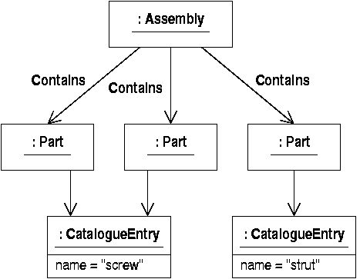
Assemblies
Assemblies contain parts
  Links show which assembly a part belongs to

Slide 22
Implementing Assemblies
Assemblies could be implemented using a data structure to hold references to parts
      public class Assembly {
        private Vector parts = new Vector() ;
        public void add(Part p) {
        parts.addElement(p) ;
        }
      }
These links are instances of a new association

Slide 23

The 'Contains' Association
‘Contains’ is the association name
  “an assembly contains parts”
‘parts’ is the rolename
Assemblies can contain zero or more parts
  this is documented by the ‘parts’ multiplicity

Slide 24
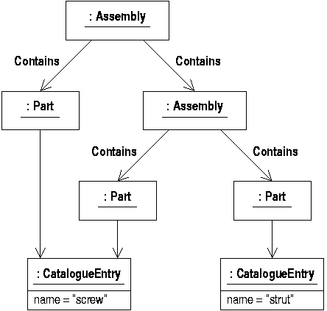
Subassemblies

Slide 25
Polymorphism
This requires assemblies to hold a mix of pointers to parts and (sub)assemblies
Inheritance is often used to implement this:
      public abstract class Component { ... }
      public class Part extends Component { ... }
      public class Assembly extends Component {
      private Vector components = new Vector() ;
      public void addComponent(Component c) { components.addElement(c) ;
      }
      }

Slide 26
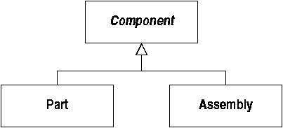
Generalization
Java’s ‘extends’ relationship is represented by generalization in UML
  Also called specialization if viewed ‘downwards’

Slide 27
Properties of Generalization
Generalization is not an association:
  does not give rise to links between objects
  usually unlabelled
  never has multiplicity annotations
Explained by ‘substitutability’:
  an instance of a subclass can be used wherever an instance of a superclass is expected
  similar to ‘reference conversions’ in Java

Slide 28
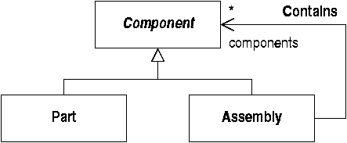
A Polymorphic Association
Assemblies contain Components:
  instances of ‘Contains’ can link assemblies to instances of both Component subclasses
  the Component class is abstract (no instances)

Slide 29
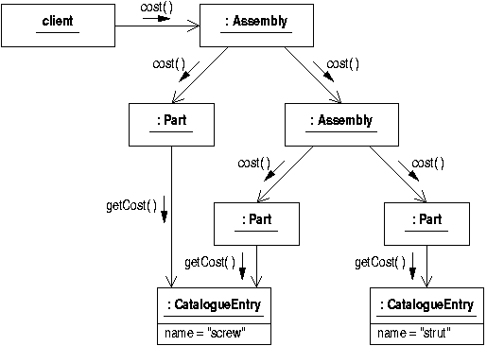
The Cost of an Assembly
Add up the cost of all the components

Slide 30
Dynamic Binding
Both ‘Part’ and ‘Assembly’ classes must implement a ‘cost’ method
An assembly sends the ‘cost’ message to all its components
The run-time system checks the type of the message receiver and invokes the correct method

Slide 31
Applicability of Object Model
Some classes inspired by real-world objects
Real-world doesn’t necessarily provide a good software design
  e.g. data replication in the original ‘Part’ class
Object-orientation better understood as an effective approach to software architecture

